Slide 1
CS 345 File Systems
Chapter 12

Slide 2
Peer Evaluations
Your presentation will be peer graded this semester and represent 10% of your final grade.
25% Complete
Self-contained – Stands on its own
Concise – All points relevant
Resolution – Adequately addressed topic
25% Insightful
Researched
Thoughtful
Shows effort
25% Presentation
Materials, slides, handouts, examples
Flow / stage presence / time
Well organized – intro/summary
25% Your peer evaluations
Insightful, accurate, fair evaluation
Submitted evaluations for majority of presentations

Slide 3
File Management
How would you describe “File Management”?
Field
Basic element of data (name, date, etc.)
Record
Collection of related fields treated as a unit (employee record)
May be of a fixed or variable size
File
Collection of similar records
Treated as an entity by applications
Usually referenced by a name
Access controls usually at file level
Database
Collection of related data files
Relationships are explicit
Used by a number of applications

Slide 4
Common Operations
Name some common file management operations:
Retrieve All – Get all the records
Retrieve One – Get just one record
Retrieve Next – Get the next record in a specified sequence (sorted order)
Retrieve Previous – Get record before this record
Insert One – Add a new record to the file, possibly in a specific position
Delete One – Remove an existing record
Update One – Get a record, change it in some way, then write it to the file
Retrieve Few – Get a set of records, often ones that meet a specific criteria (students in CSC 345)

Slide 5
File Management
What are the objectives/requirements?
Objectives
Meet the data requirements of the user
Guarantee valid data (except GIGO)
Optimize performance - both throughput and response time
Support a wide variety of devices
Minimize lost or destroyed data
Provide a standard set of I/O routines
Provide support for multiple users
Minimal Requirements:
Create, delete, change files
Control other’s access to files
Restructure files as appropriate
Able to move data between files
Back up and recover files
Reference files by a symbolic name

Slide 6
File System Architecture
What is the architecture of a file system?
Device Drivers
Communicate directly with device
Basic File System
Buffering, placing data on device
Basic I/O Supervisor
I/O initiation and termination
Logical I/O – Deals with records
Access method (sequential, hashed, …)
Standard interface with the user
Pile
Seq
Indx
…
Hash
Logical I/O
Basic I/O Supervisor
Basic File System
Device Drivers

Slide 7
File System Implementation
Application Programs
Directory
Protection
Security
Logical File System
File Organization Module
Files <--> Blocks
Free Space Mgr.
Issue commands
to appropriate
driver
get block 123
Basic File System
Device Drivers
Interrupt Handlers
input: get block 123
output: low-level inst.
I/O Control
Devices

Slide 8
File Management System
What level of interaction does a user have with a file management system?
User interacts using commands for creating, deleting, and performing operations on files.
Must understand directories
Enforce user access control
User works on the record level
O.S. combines records into blocks
Transfers blocks from/to devices
I/O requests must be scheduled
File Management System is a separate system utility

Slide 9
Elements of a File System
Physical blocks in main memory buffers
Physical blocks in secondary storage (disk)
File structure
Directory management
Access method
Records
Blocking
Disk scheduling
User & program
commands
File operations
file name
File manipulation functions
I/O
File allocation
User access control
Free storage management
File management concerns
Operating system concerns

Slide 10
File Organization
What might need to be considered in choosing a file organization?
Criteria:
Rapid access
Ease of update
Economy of storage
Simple maintenance
Reliability
These criteria may vary in importance or conflict
Economy of storage – minimum redundancy
Redundancy – increase speed of access
CD-ROM – Ease of update irrelevant
Indexes – Faster but uses more storage

Slide 11
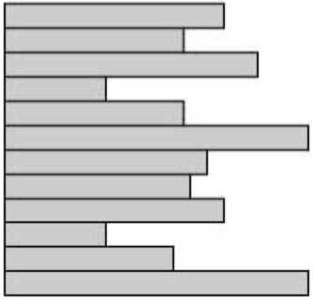
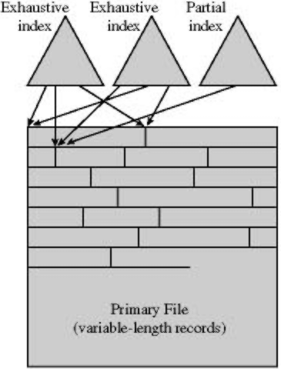
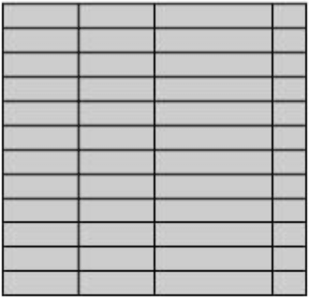
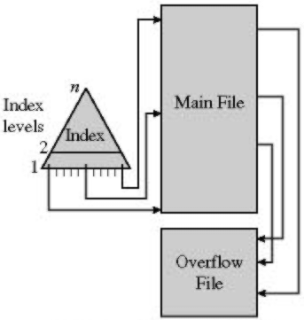
File Organization
Five common organizations
Pile
Sequential file
Indexed sequential file
Indexed file
Direct (Hashed) file

Slide 12
File Organization
Pile
Add data to the file as it arrives
Record size and field order may vary
Requires use of exhaustive search
Sequential File
Fixed record format
Size and order of fields fixed
Key field - unique record ID
Records stored in order based on key
Handles random requests poorly
Must use sequential search (batch system)
Hard to insert new records

Slide 13
File Organization
Indexed Sequential File
Adds an index to speed lookup
Index file is a sequential file
May have multiple levels of indexes
Overflow area to handle new records
Link from main records to overflow, back
Indexed File
May have multiple indexes
One for each field we may search
Records accessed only through the indexes
Each index may be exhaustive or partial

Slide 14
File Organization
Indexed File
Easier to support variable-length records
Index entries can point to arbitrary locations in the file
Generally don’t process all records in the file at one time (reservations)
Mostly used where speed is important but the file is rarely processed exhaustively
Direct (Hashed) file
Use hashing on a key to find the record
No notion of sequential access
Generally used when rapid access to one record is required (directory)

Slide 15
File Directories
What is a directory?
Holds information about the files
Name, attributes, owner
Directories typically stored as files
Usually includes information about who is allowed to access the file
Operating system manages directory information
Usually users can only access via system routines
User sees directory as mapping from names to files
Most importantly, location and size
System may also support different kinds of files
VAX does, UNIX doesn’t

Slide 16
Directory Entries
What would be stored in a directory entry?
Basic
Name – Unique in directory (possibly file versions)
Type – Text, binary, load module, etc.
Organization – Sequential, indexed, etc.
Address
Device – Which disk holds the file
Often this must be the same device as the directory is on
Starting address/Blocks used
Block #, cylinder #, or other location id
Size used – Current file size
May be in bytes or blocks
Size allocated – Maximum space allocated for this file
Not used on all file systems

Slide 17
Directory Entries (continued…)
Access Control
Owner – Who has control of the file
Access Information – What users are allowed to work with the file
Permitted Actions – Controls reading, writing, etc.
Usage Information
Date Created
Identity of Creator
Date Last Read Access
Identity of Last Reader
Date Last Modified
Identity of Last Modifier
Date of Last Backup
Current Usage – Who has the file open, is the file locked, are there updates waiting in main memory?

Slide 18
Directory Structure
What should be considered in a directory structure?
Operations to support:
Search for the file entry (open)
Create a new file
Delete a file
List the files in the directory
Update directory
Simplest form
A list of directory entries, one for each file (CP/M, DOS 1.0)
Difficult to handle large numbers of files or multiple users
Cannot conceal files from other users

Slide 19
Directory Structure (continued…)
More complex form
One directory for each user and a master directory
Easier to manage access information
Users still can’t structure collection of files
Hierarchical or Tree-structured file system
Single master (root) directory
DOS: Master directory for each drive
Each directory may contain files and other subdirectories
Names only unique in directory
Each directory often stored as a sequential file
Less effective when there are a large number of files in a given directory

Slide 20
Directory Structure (continued…)
Path - following set of directories from master directory to file
Example: /UserB/Word/UnitA/ABC
“/” often used to separate directories
File names not unique – only unique pathnames
Current or working directory
Files referenced relative to working directory
Current directory for files: /UserB/Word
Files in this directory unless path given

Slide 21
File Sharing
What “rights” are assigned to a file?
None – Others don’t know it exists
Prevent users from reading the parent directory (Unix)
Need explicit permission bit for access to the file name (Novell)
Knowledge – Know it is there and who the owner is
Execution – Able to run a program
Read – Look at or copy contents
Execute and Read may be independent
Append – Add to but not modify data in file
Update – Modify/delete/add data
Change Protection – Grant rights to file
Owner can specify what other users have rights to this file
Deletion – Can delete file

Slide 22
File Sharing (continued…)
Right may be granted to
A specific user - May allow different users to have distinct permissions
A group of users
The world (public files)
Simultaneous Access
Multiple users may want to access or modify the same file
Example: Airline reservation database
Locking: Entire file vs. Records
Easier to lock entire file
Locking records allows more concurrency
Instance of reader/writer problem
Must address mutual exclusion and deadlock

Slide 23

Record Blocking
What is record blocking?
Fixed length or variable length?
Simpler to have fixed-length records
Larger blocks transfer more records per I/O operation
Wastes space/time if other records not used (random reads)
Fixed-length Blocking
Assumes fixed-size records
Integral # of records per block
May waste space at the end of a block
Easy to find an arbitrary record

Slide 24


Record Blocking (continued…)
Variable-length - spanned blocking
A record may be split between blocks
Have to read both blocks for that record
Wastes space only at the end of the file
Variable-length un-spanned blocking
Each record held entirely in one block
Limits the size of a record
May waste space at the end of a block

Slide 25
File Allocation
How are files allocated resources?
Issues in file allocation
When a new file is created, do we specify the maximum size?
How big of a unit should we use when allocating space for a file?
How do we keep track of what space has been allocated to a given file?
Problems tend to mirror memory allocation problems

Slide 26
File Allocation
Pre-allocation
Declare max size in advance
May be hard to guess space needed
Tendency to overestimate space needed
Ok if the file will never change
Dynamic allocation
Get space as the file needs it
Files are often no longer contiguous

Slide 27
File Allocation
Portion (unit) size
Larger units increase are more contiguous and increase performance
Having lots of small units requires more space for allocation tables
Fixed-size portions simplifies the reallocation of space
Variable-sized units or small fixed-size units reduces wasted space

Slide 28
File Allocation
Two common alternatives:
Variable-sized large contiguous portions
Minimizes waste, allocation overhead
Have to deal with fragmentation
First-Fit, Best-Fit, Nearest-Fit allocation
Blocks – Small fixed-size portions
Abandons contiguity
Allocate blocks as needed

Slide 29
Contiguous Allocation
A single contiguous set of blocks assigned to a file when it is created
Preallocation strategy with variable-sized portions
Good performance (especially for sequential files)
External fragmentation tends to occur
Use compaction to combine free space
Used by CD-ROMs (ISO 9660)

Slide 30
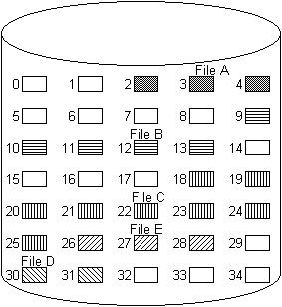
Contiguous Allocation
Example (Figure 12.7, Page 546)
After compaction see Figure 12.8, page 546

Slide 31
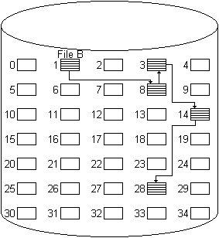
Chained Allocation
Allocate on the basis of individual blocks
Directory only links to the first block
Each block points to the next block
Easy to add blocks to a file
No external fragmentation
No accommodation for locality
MSDOS FAT12/16/32 is a variation
Best suited to sequential files

Slide 32
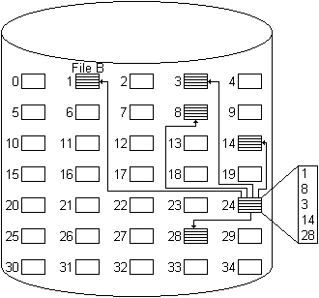
Indexed Allocation
Directory has an entry for a index block
Index may or may not be in directory entry
Index block has pointers to the data blocks in the file
Portions may be fixed or variable size
Supports both sequential and direct access to a file
Most common form of allocation
Unix uses a variation on this

Slide 33
Free Space
Recording Free Space
Bit Tables – Free bit for each block
Example bit vector for Figure 12.7
00111000011111000011111111111011000
May divide disk into sections to make the table portion to be searched smaller
Chained Free List
Low overhead – Store pointers in blocks
Indexing
Free space is a “file”, store list of blocks in the same manner as ordinary files

Slide 34
Free Space
Free Block List
Keep locations of free blocks on disk
Can treat it as a stack and re-allocate recently freed blocks – only the last few blocks need to be kept in memory
Can use FIFO order
May have a background process that works to facilitate contiguous allocation
Where to store allocation tables
Memory
Table size may be a problem
Information may be lost if it crashes
Disk
Requires extra read/write to allocate a block - slows system down dramatically

Slide 35
Free Space
What are some reliability issues with file free space allocations?
Unix/Windows – Memory allocation with “clean file system” flag
Handling system crashes
Lock the allocation table on disk, do the allocation, update the disk
Will make the system very slow
May choose to preallocate a batch of blocks, then allocate to files on demand
Mark it “in use” on disk
Clean it up when a crash occurs

Slide 36
DOS File System
Unix Inodes
Linux Disk Allocation
NTFS
ISO-9660

Slide 37
DOS File System
MBR - first sector on disk
boot code and partition table (4 entries)
Type of partition (FAT16, FAT32, Linux)
Start and Size of the partition
Extended partitions – Used if more than 4 partitions – held in 4th partition
Boot Sector – Partition first sector
Number and size of FATs
Size of root directory (FAT 12/16)
Starting cluster of root directory (FAT32)
Sectors per cluster (1 to 64)
Total number of sectors, boot code

Slide 38
DOS File System
FAT - array of 12/16/32-bit entries
Clusters 0, 1 not used
0 = free cluster
F…F7 = bad cluster
F…F8 = end of cluster chain
other = next cluster in the chain
Root Directory
Consecutive sectors for FAT 12/16
Same as a subdirectory for FAT 32

Slide 39
DOS Directories
Directory Entry Structure
Filename (8), extension (3)
Padded with spaces (“PROB.C” becomes “PROB C “)
First char: E5 if deleted, 00 if never used
Attributes (archive, directory, label, system, hidden, read-only)
Date/Time of last change
Starting Cluster
File Size
Long File Names
Use one or more directory entries
13 Unicode chars in each entry
Ignored by DOS, linked to DOS entry

Slide 40
Unix Files
Four types distinguished:
Ordinary – information from user, application, or system utility
Directory – list of file names w/pointer to index nodes (inodes)
Special – used to access peripheral devices (terminals or printers)
Named Pipes – I/O between processes
Unix uses an Inode (an information or index node) to keep track of file allocation

Slide 41
Unix Inodes
Inode – an information or index node holds key information
Several file names may be associated with a single inode
An active inode is associated with exactly one file and each file is controlled by exactly one inode
File allocation on a block basis and dynamic
An indexed method keeps track of each file
The first 10 addresses in an inode point to the first 10 blocks of a file
The 11th address points to a block containing the next portion of the index (single indirect block)
The 12th address points to a block of addresses that point to additional single indirect blocks (double indirect block)
The 13th (and final) address points to a triple indirect block that is a third level of indexing.
Unix Superblock – monitors inodes

Slide 42
Unix (Inode)
data
File Mode
Link Count
Owner ID
Group ID
File Size
Direct0 (1k)
Direct1 (1k)
Direct2 (1k)
Direct3 (1k)
Direct4 (1k)
Direct5 (1k)
Direct6 (1k)
Direct7 (1k)
Direct8 (1k)
Direct9 (1k)
single indirect (256k)
double indirect (65M)
triple indirect (16G)
Last Accessed
Last Modified
Inode Modified
data
data
.
.
data
data
data
.
.
data
data
.
.
data

Slide 43
Linux Disk Allocation
Directory
List of filename/inode pairs
Bitmap to indicate free or allocated blocks
Look for a free block near the current block
Else try to find byte of free bits
Back up to last free block, then pre-allocate 8 or more blocks
Released when file is closed if not needed
Block Groups
Set of nearby blocks
Helps keep the directory, inodes, and corresponding files close to each other
Always try to allocate a file in the same block group as the parent directory
Directories spread among block groups

Slide 44
NTFS
Features
Recoverability – Log file to note changes
Security
Large disks/large files
Multiple data streams within a file
Macintosh: Data/Resource forks
General indexing facility
Storage units
Sector
Cluster – Set of 1 to 128 sectors
Fundamental allocation unit
Helps handle sector sizes other than 512 bytes
Default cluster size depends on disk size (Table 12.6)
Volume – Logical disk partition
May be all or part of a single disk
With RAID, may span several disks
Max size is 2⁶⁴ bytes

Slide 45
NTFS - Volume Layout
Boot sector(s) – Up to 16 sectors long
Includes volume and file system info
Master File Table
Database structure of variable-length rows, each describing one file or folder
If the file is small, may contain the file
Holds information about files and directories, free space
MFT2 – Copy of first three rows of MFT
Log file – List of file transaction steps
Cluster bit map – Indicates free space
Attribute definition table – Supported attribute types (Table 12.7, page 558)
System Files
Other Files

Slide 46
NTFS - Recoverability
Key elements (Fig 12.15, page 559)
I/O Manager – Handles basic open, close, read, write, software RAID
Log File Service – Keeps a log of disk writes in case of a system crash
Cache Manager – Optimize disk I/O by lazy write and lazy commit
Virtual Memory Manager – maps file references to virtual memory references
Emphasis is file system structure data, not user data
Log file can be used to undo/redo changes
File update steps
Call log file system to record changes to the volume structure
Modify the volume in cache
Cache manager calls log file system to flush log file to disk
Cache manager flushes volume changes to disk

Slide 47
ISO-9660
CD-ROM file system
Rock Ridge – Linux extensions for longer file names, uid/gid, permissions
Joliet – Microsoft extensions to allow long file names
Data stored in sectors
2352 bytes each (2048 data, 304 ECC)
Most values held in both little-endian and big-endian form
Directory entry:
First sector in file and size (files are always contiguous)
Extended attribute info
Hidden/Directory flags
Date/Time for file
Name of file (uppercase, digits, _)
System use area (optional)

Slide 48
Volume Descriptor
Same purpose as MBR/boot sector
Primary descriptor in sector #16
Secondary descriptors (Joliet) follow in succeeding sectors
For multi-session CDs, look at the most recent session for descriptors
Contents:
System and Volume identifier
Total # of sectors on the disk
Path table location and size
Both little-endian and big-endian tables
Directory entry for root directory
Identifiers for volume set, publisher, copyright, data preparer, others
Date/time of creation, when volume is effective or expires, last modification

